Slide 1

Shopping
demo

Slide 2
1
Part 01
install
CONTENTS
2
Part 02
about this project
3
Part 03
detail
4
Part 04

Slide 3
Part 01
Install

Slide 4
Install
1、win+R to open CMD
2、cd to the folder path
3、run `npm i` command
2、rename the file named .env.local.ts to .env.local（equal to delete ‘.ts’）
3、run `npm run dev` command
4、open browser and input `http://localhost:3000`
install guide video
https://drive.google.com/file/d/1YUjPuQqzlf9v6FnHqu1Q5ippICT2G8Tx/view?usp=sharing
Click here to add content of the text，and briefly explain you point of view
Click here to add content of the text，and briefly explain your point of view

Slide 5
Part 02
About this project

Slide 6
About this project
reason
sell products、try new skills(php mysql)
difficulity
can’t conect to backend
how to solce
finally choose another way
felling

Slide 7
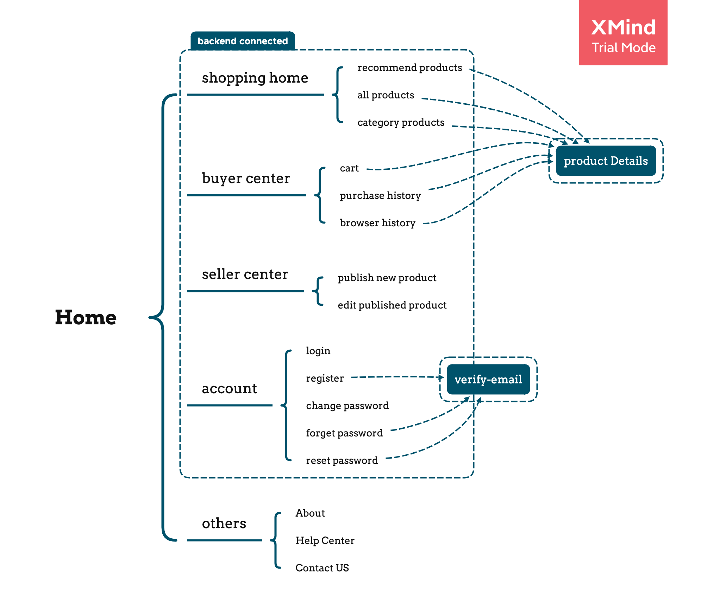
Structure
Click here to add content of the text，and briefly explain you point of view
Click here to add content of the text，and briefly explain your point of view

Slide 8
Part 03
detail

Slide 9
detail
shoping home
1、recommend products
2、all products
3、category products
Click here to add content of the text，and briefly explain you point of view
Click here to add content of the text，and briefly explain your point of view

Slide 10
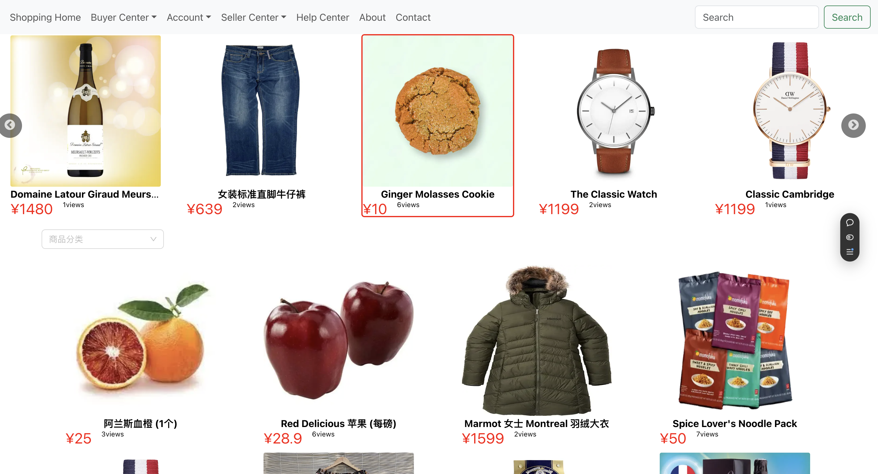
detail
shoping home
1、recommend products
Click here to add content of the text，and briefly explain you point of view
Click here to add content of the text，and briefly explain your point of view

Slide 11
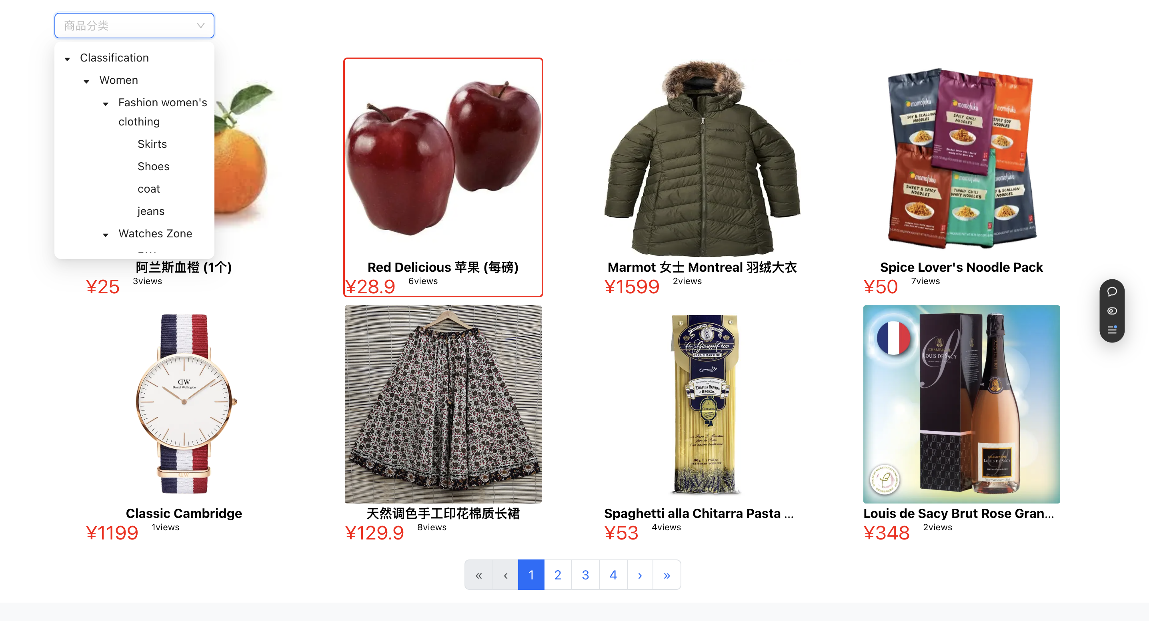
detail
shoping home
2/3、all products / category products
Click here to add content of the text，and briefly explain you point of view
Click here to add content of the text，and briefly explain your point of view

Slide 12
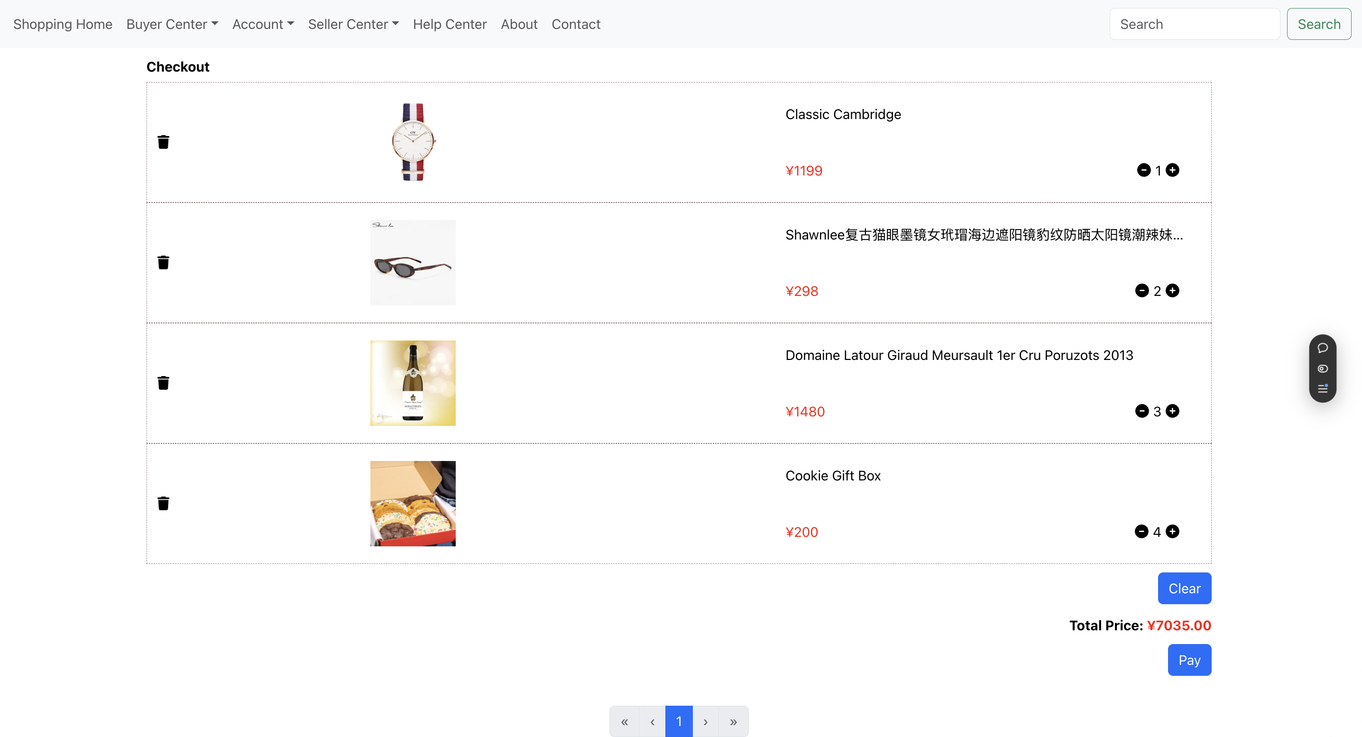
detail
buyer center
1、cart
Click here to add content of the text，and briefly explain you point of view
Click here to add content of the text，and briefly explain your point of view

Slide 13
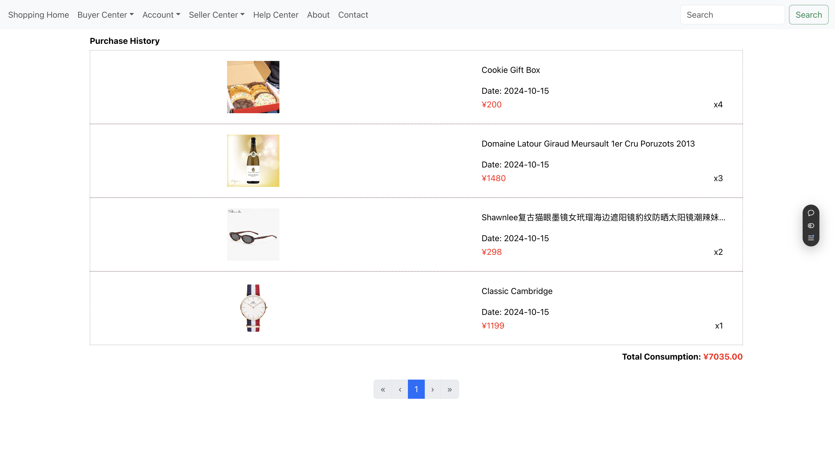
detail
buyer center
2、purchase history
Click here to add content of the text，and briefly explain you point of view
Click here to add content of the text，and briefly explain your point of view

Slide 14
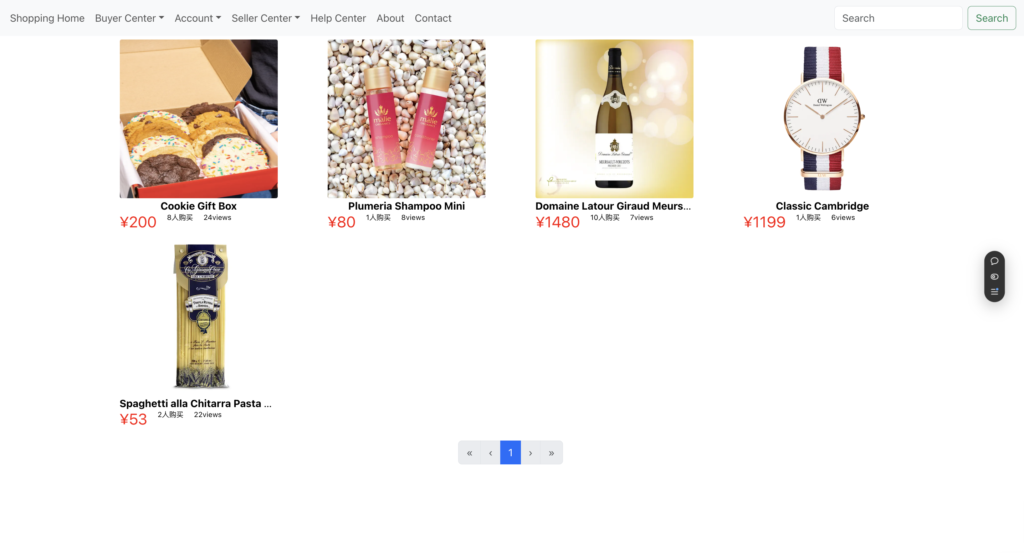
detail
buyer center
3、browser history
Click here to add content of the text，and briefly explain you point of view
Click here to add content of the text，and briefly explain your point of view

Slide 15
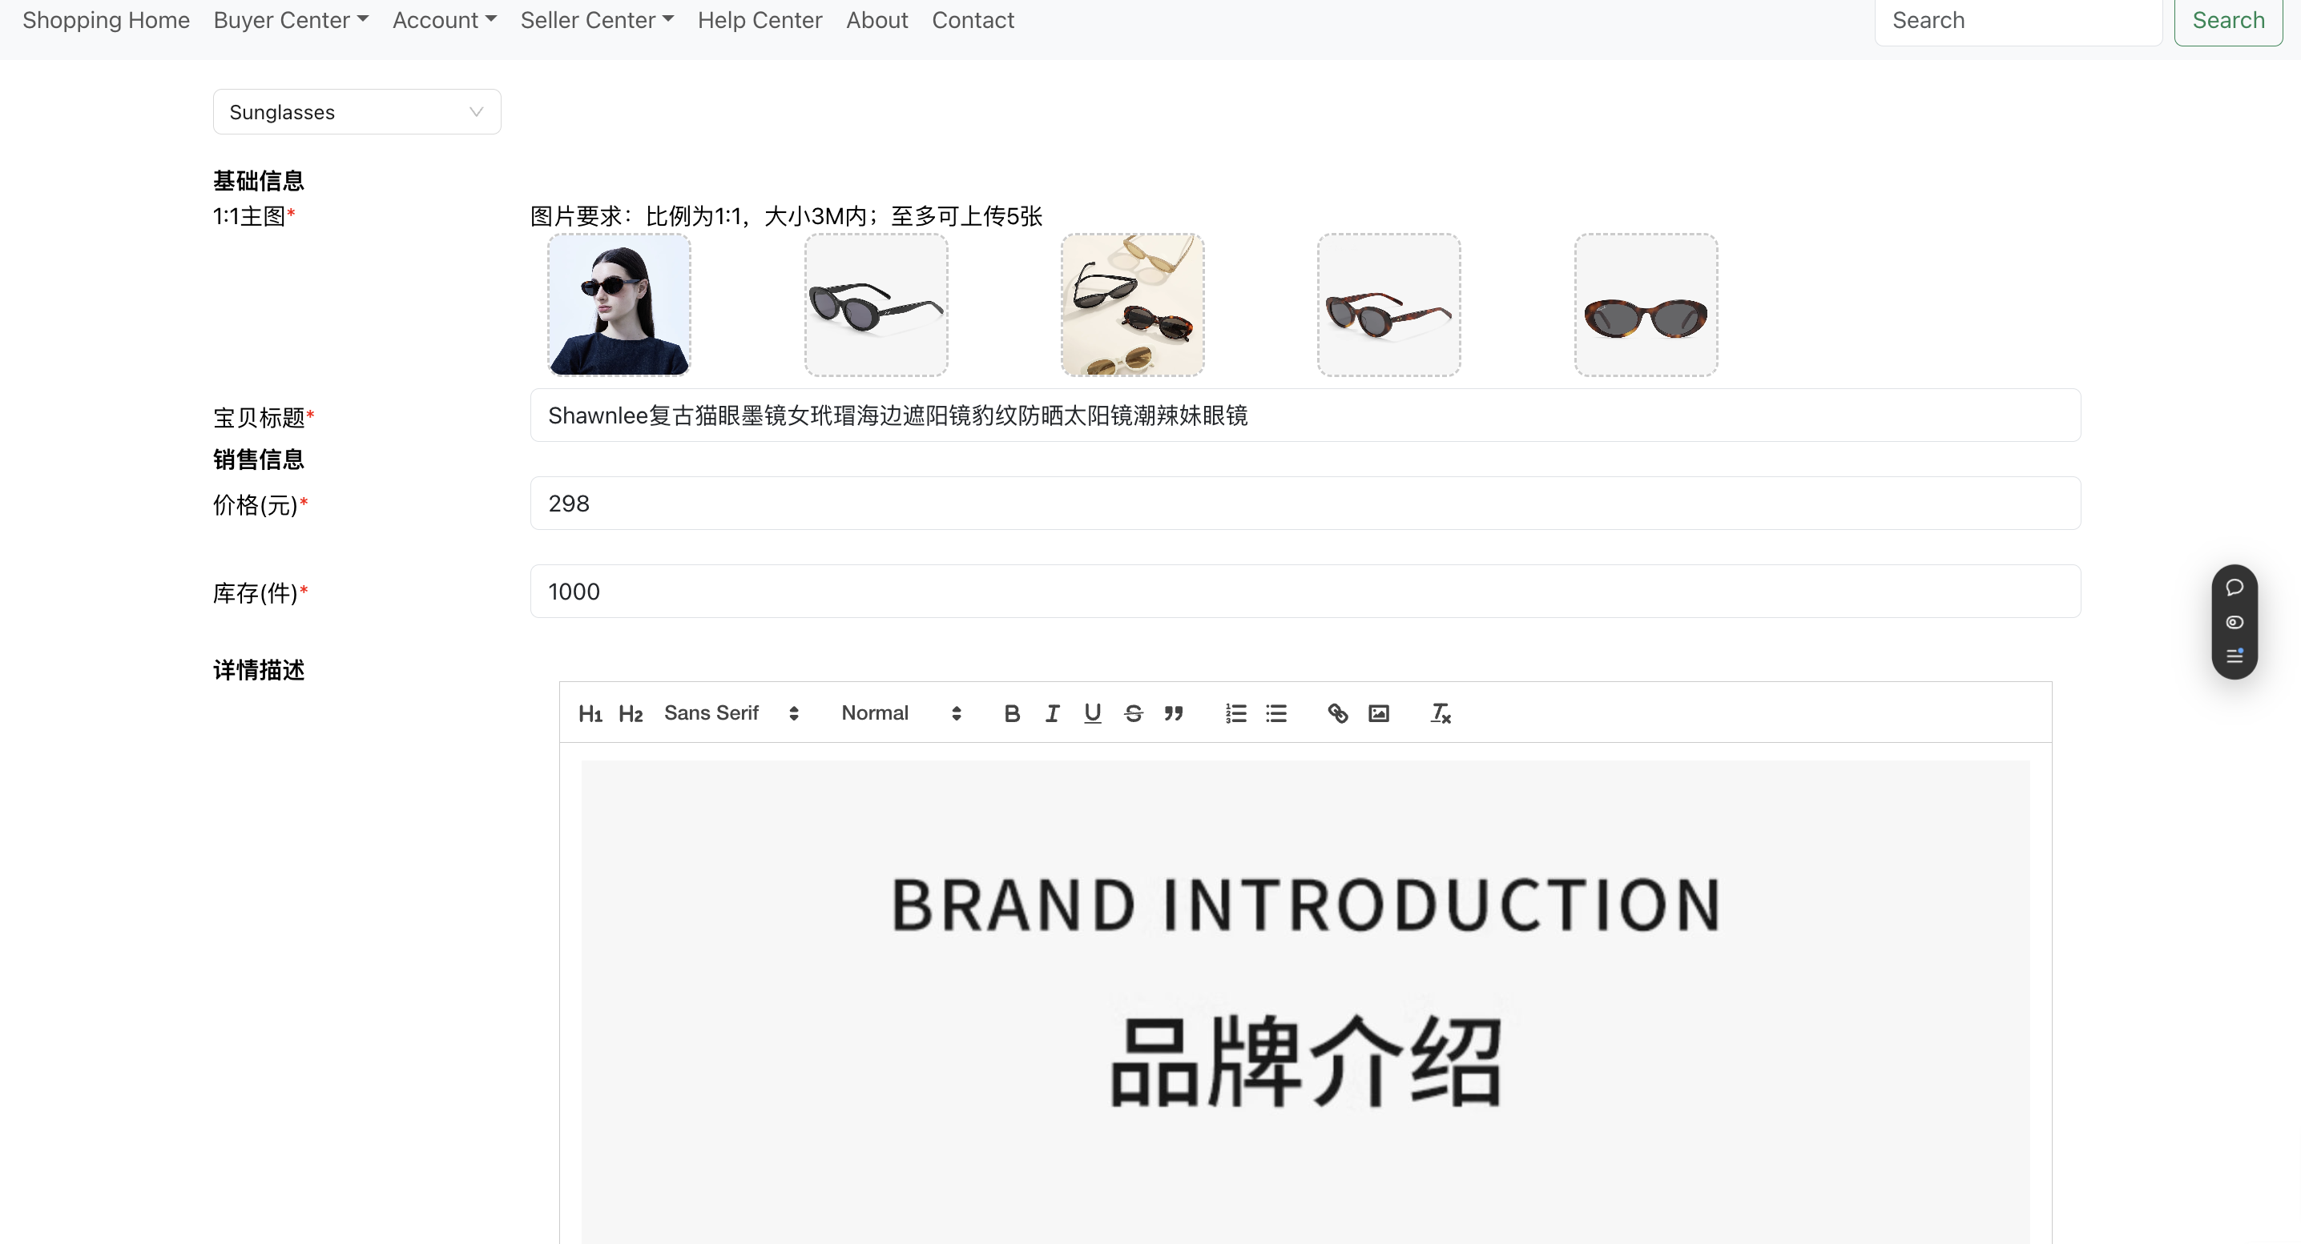
detail
sellerr center
1、pulish product
Click here to add content of the text，and briefly explain you point of view
Click here to add content of the text，and briefly explain your point of view

Slide 16
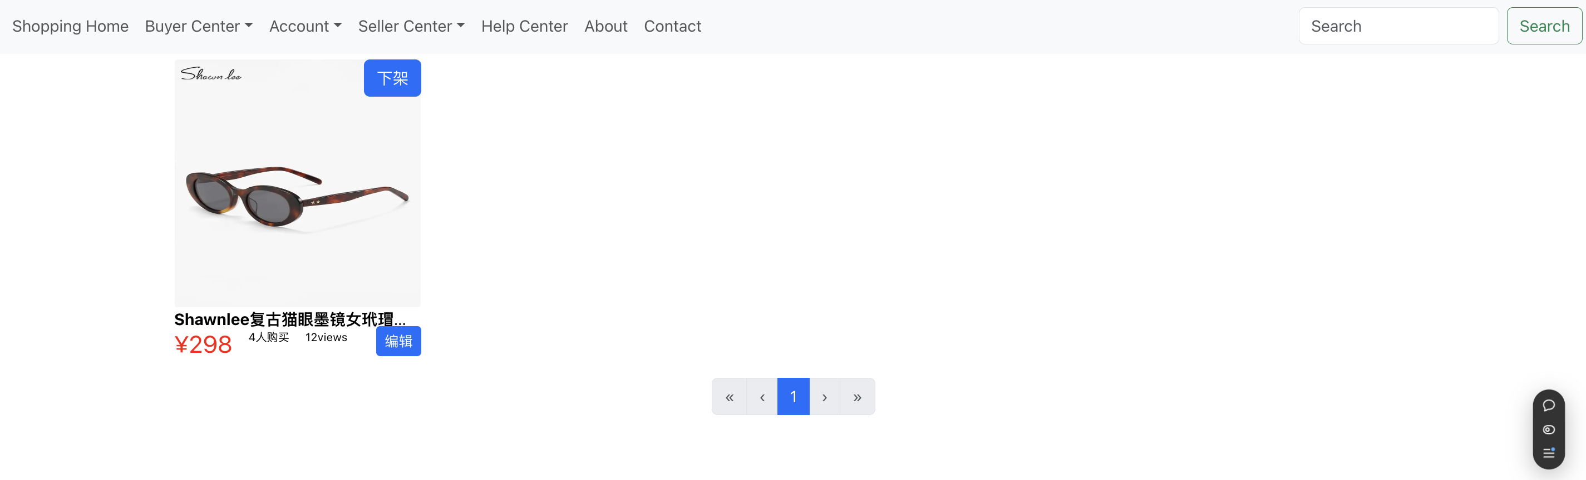
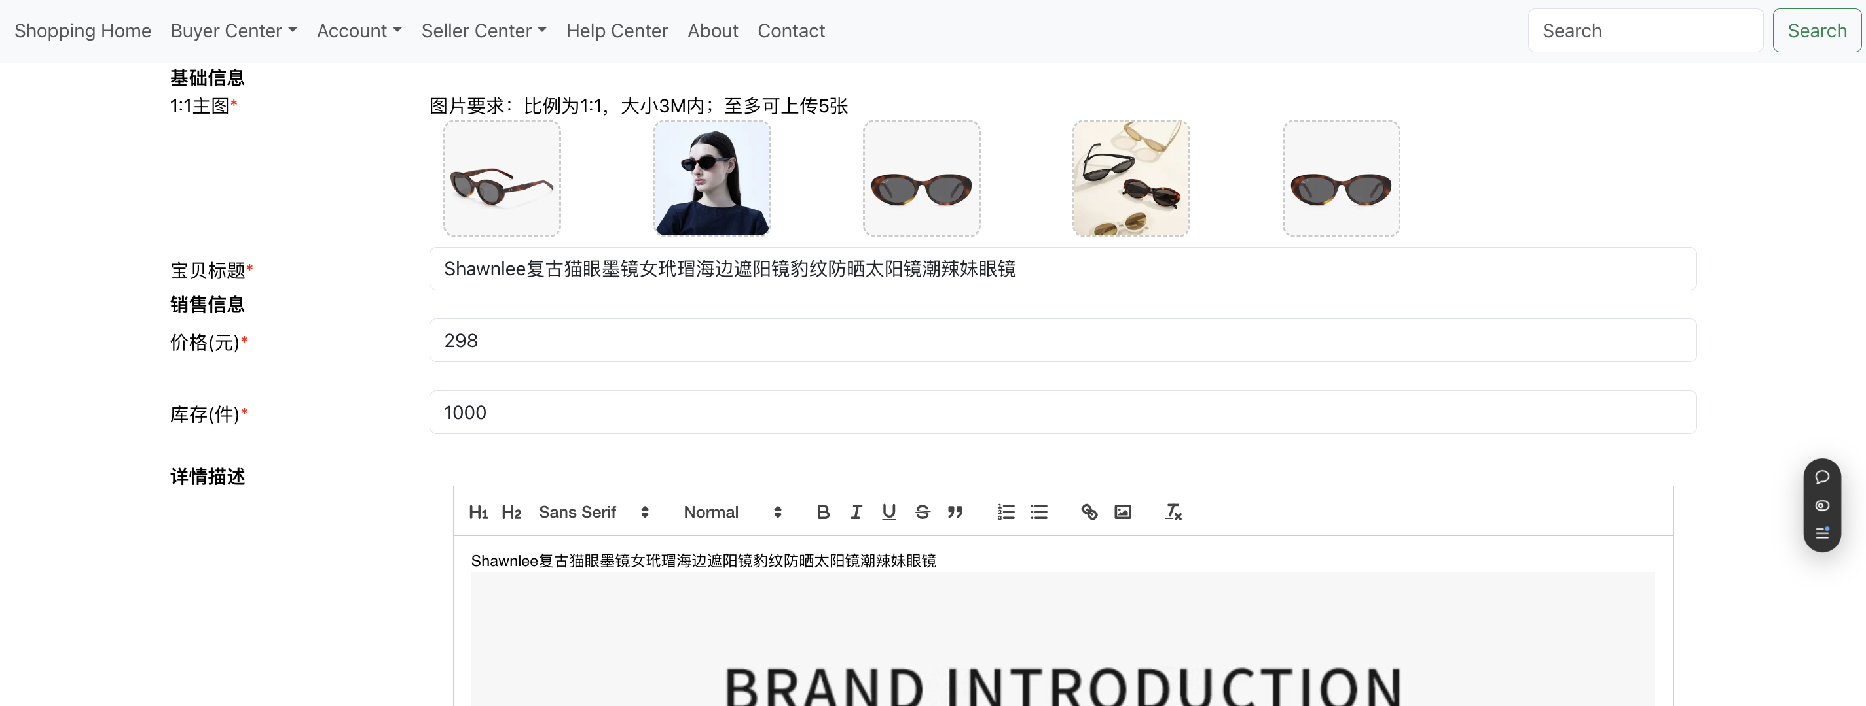
detail
sellerr center
2、edit pulished product
Click here to add content of the text，and briefly explain you point of view
Click here to add content of the text，and briefly explain your point of view

Slide 17
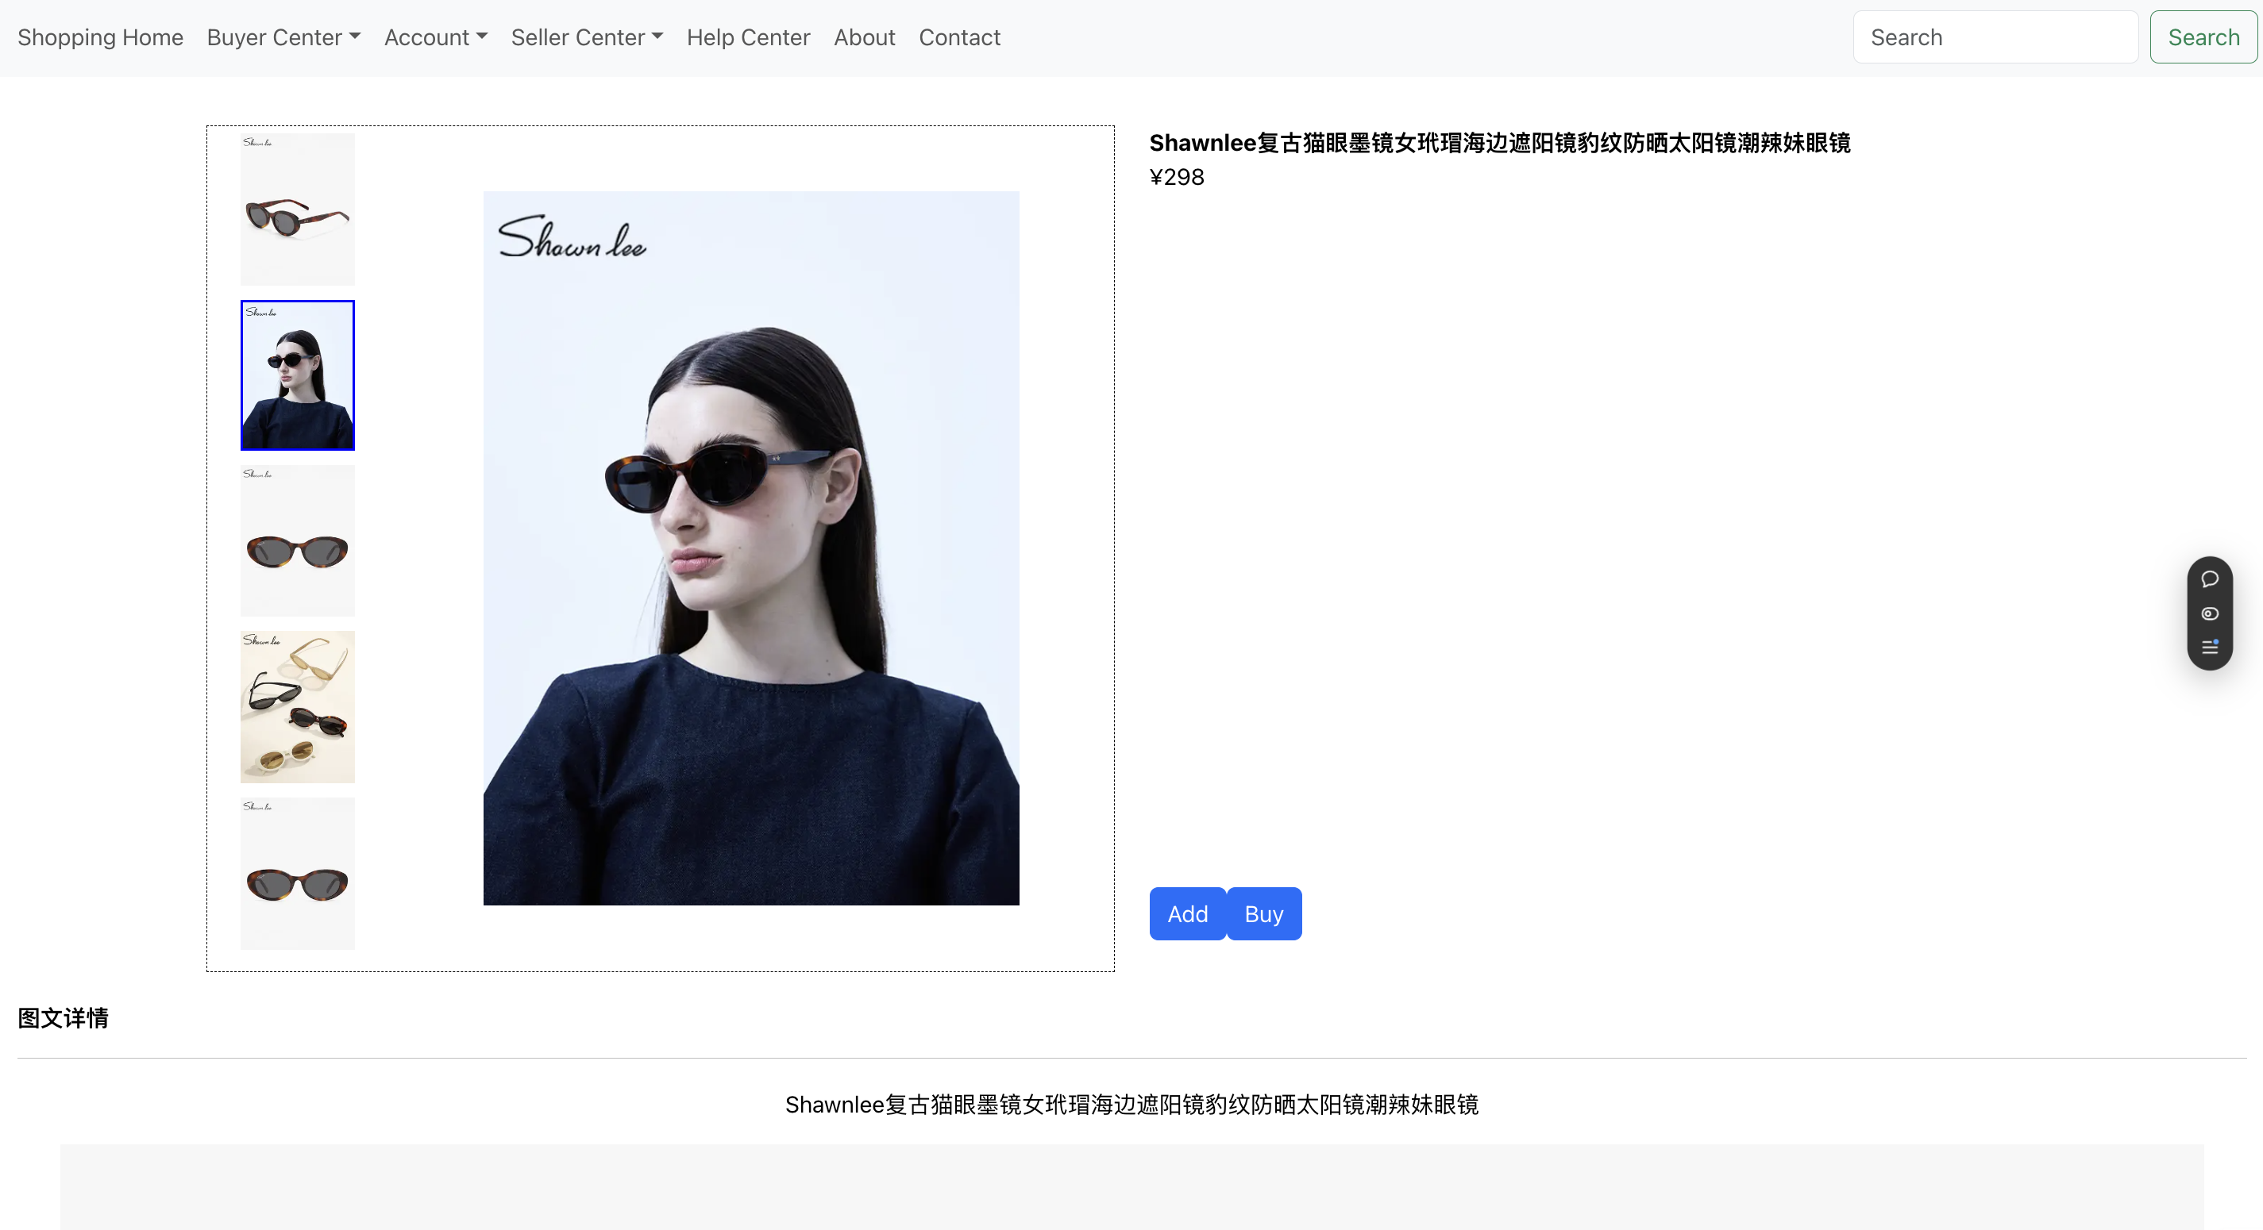
detail
product detail
Click here to add content of the text，and briefly explain you point of view
Click here to add content of the text，and briefly explain your point of view

Slide 18
function
账号相关：注册、登录、修改密码、忘记密码
购物相关：发布商品、重新编辑已发布商品、商品分类筛选、商品详情、购物车、
历史购买记录、历史浏览记录
Click here to add content of the text，and briefly explain you point of view
Click here to add content of the text，and briefly explain your point of view

Slide 19
分工
Click here to add content of the text，and briefly explain you point of view
Click here to add content of the text，and briefly explain your point of view

Slide 20
thank you

